Slide 1

Facility Services
Staffing overview FY24 & staffing request for FY25

Slide 2
28 Year Staff History

Slide 3
Organizational chart

Slide 4
Vehicle fleet
Year | Make | Model | Drivetrain | Assignee
2008 | Chevrolet | Silverado | 2wd | Maintenance
2008 | Chevrolet | Silverado | 2wd | Maintenance
2008 | Chevrolet | Silverado | 2wd | Custodial
2009 | GMC | Sierra | 2wd | Construction Crew
2015 | Chevrolet | Silverado | 2wd | Custodial
2015 | Chevrolet | Silverado | 2wd | Maintenance
2016 | Chevrolet | Silverado | 2wd | Custodial
2017 | Chevrolet | City Express Van | 2wd | Custodial
2022 | Chevrolet | Silverado | 4x4 | Maintenance
2022 | Chevrolet | Silverado | 4x4 | Maintenance
2022 | Chevrolet | Silverado | 4x4 | Maintenance
2022 | Chevrolet | Silverado | 4x4 | Director
2023 | Chevrolet | Silverado | 4X4 | Construction Supervisor
2023 | Chevrolet | Silverado | 2wd | Maintenance
2023 | Ford | F150 | 2wd | Maintenance
2023 | Ford | F150 | 2wd | Maintenance
2024 | Chevrolet | 2500 | 2wd | Grounds
Total- 17

Slide 5
Property Portfolio

Slide 6
Work orders completed – last 7 years
Notes:
Not all Non-PM work orders are able to be entered into the system due to work load, some are completed and never entered into the system.
Custodians do not currently utilize the CMMS system, this only reflects Maintenance, Grounds and Construction staff work orders.

Slide 7

Importance of PROPER Staffing:
Extends the life of building systems and components.
Preventative Maintenance performed on time reduces premature failure of equipment.
Protects the county’s investments in equipment and building materials.
Instills public trust by showing responsible maintenance.
Increases value to the Taxpayer and saves tax dollars long term.
Decrease utility costs by ensuring proper operation of equipment.
Can affect the health of employees and safety of the facility.

Slide 8
Maintenance Staffing

Slide 9
Maintenance Staffing Considerations:
What is the nature of the space/building being maintained?
3 - Jails (Central, North Jail, Juvenile)
7 - Facilities housing Courts. (Courthouse, Cotton Belt, Annex, Pct.2, Pct.3, Pct.4, Pct.5)
Are there any legal requirements that must be met?
State Jail Standards as well as local, state and national laws and codes.
Are there safety/security concerns that require action?
Heavy and complicated items require an extra set of hands to perform.
Safety in the jails is always a concern.
What is the complexity of the facility, such as building systems?
Some facilities have simple systems; however, many of our facilities have complex systems.
What is the proximity between locations?
Precincts are scattered across the county.
How many assets need to be maintained?
Currently over 1000 pieces of equipment and assets in our system.
How many annual work orders are completed?
FY23, we completed 15,863 total work orders.
Age of the facilities/assets?
Many of our facilities and their systems are well aged.
Type of maintenance program required? Ex. Reactive/Preventative/Predictive
We currently have a Preventative Maintenance Program in place, however, there will always be Reactive Maintenance required.

Slide 10
International Facility Management Association (IFMA) -
Operations and Maintenance Benchmarks Research - Report #26.
The recommended maintenance staffing ratio is 47,000 square feet per full time employee.
This places us well over the recommended maintenance staffing ratio for most buildings.

Slide 11
FM Pulse – National Survey 2017
After surveying an array of facility types and industries across the nation, it was concluded that the median number of square feet per full time maintenance employee is 50,000 square feet.
This places us well over the recommended maintenance staffing ratio for most buildings.

Slide 12
Maintenance current Assignments:
Notes:
We don’t have near have enough maintenance staff to properly staff and maintain the number of building/square footage that we are responsible for. Central Jail & Tower should at a minimum be running a fully staffed day shift and a fully staffed night shift.
North Jail should ideally have two maintenance mechanics maintaining the Jail & Kitchen/Visitation/Laundry facilities.
The new R&B buildings (26,621 sf) that were built are in new condition and should be better maintained than the old ones. The facilities are larger in size than the old ones (19,283 sf).
We’re currently constructing a multi-level parking garage that will add additional maintenance workload. (543 parking spaces and 178,272 sf)
  6 – A/C units
  Irrigation system
  Groundskeeping
  Lighting system
  Elevators
Maintenance Assignments (Current) - 50,000 sqft per FTE standard
Building | Sqft |  | Staff
Animal Shelter | 11,300 |  | 1
Annex | 74,626
S.O. Admin | 18,616
CSCD | 12,100
Elections | 9,019
Total Sqft | 125,661 | Sqft assigned per FTE | 125,661
Central Jail & Tower | 223,745 |  | 4
Total Sqft | 223,745 | Sqft assigned per FTE | 55,936
North Jail & Visitation/Kitchen/Laundry | 51,757 |  | 1
Total Sqft | 51,757 | Sqft assigned per FTE | 51,757
Courthouse | 67,632 |  | 1
Evidence | 7,721
Facility Services | 2,136
Total Sqft | 77,489 | Sqft assigned per FTE | 77,489
Pct.1 Constable | 2,811 |  | 1
Pct.2 Noonday | 4,400
Pct.3 Troup | 4,840
Pct.4 Winona | 5,940
Pct.5 Lindale | 6,170
Road and Bridge | 18,000
FCIC | 9,304
Total Sqft | 51,465 | Sqft assigned per FTE | 51,465
Juvenile | 57,590 |  | 1
Cotton Belt | 128,608
EOC | 15,126
Total Sqft | 201,324 | Sqft assigned per FTE | 201,324
Skilled Trade Specialist (HVAC) |  |  | 1
Total Sqft | 0 | Sqft assigned per FTE | 0
Totals | 731,441 |  | 10 Staff
21 main buildings (other buildings and properties) |  |  | 8 Vehicles

Slide 13
Maintenance ideal Assignments:
Maintenance Assignments (Ideal) - 50,000 sqft per FTE
Building | Sqft |  | Staff
Annex | 74,626 |  | 2
Total Sqft | 74,626 | Sqft assigned per FTE | 37,313
Central Jail & Tower | 223,745 |  | 10
Total Sqft | 223,745 | Sqft assigned per FTE | 44,746
North Jail & Visitation/Kitchen/Laundry | 51,757 |  | 2
Total Sqft | 51,757 | Sqft assigned per FTE | 25,879
Courthouse | 67,632 |  | 1
Total Sqft | 67,632 | Sqft assigned per FTE | 67,632
Animal Shelter | 11,300 |  | 1
S.O. Admin | 18,616
CSCD | 12,100
Elections | 9,019
Evidence | 7,721
Total Sqft | 58,756 | Sqft assigned per FTE | 58,756
Facility Services | 2,136 |  | 2
Cotton Belt | 128,608
Total Sqft | 130,744 | Sqft assigned per FTE | 130,744
Pct.1 Constable | 2,811 |  | 1
Pct.2 Noonday | 4,400
Pct.3 Troup | 4,840
Pct.4 Winona | 5,940
Pct.5 Lindale | 6,170
Road and Bridge | 23,927
FCIC | 9,304
Total Sqft | 57,392 | Sqft assigned per FTE | 57,392
Juvenile | 57,590 |  | 2
EOC | 15,126
Total Sqft | 72,716 | Sqft assigned per FTE | 36,358
Skilled Trade Specialist (HVAC) |  |  | 1
Total Sqft | 0 | Sqft assigned per FTE | 0
Totals | 737,368 |  | 22 Staff
 |  |  | 12 Vehicles
Notes:
Add 1 person at the Annex for a total of two.
Add 6 people to the Central Jail (2-days/4-nights) and 2 new trucks. This will create two fully staffed shifts of 5 people each. Total staff of 10 people.
Add 1 person to the North Jail.
Add 1 person the Courthouse, it should be the flagship of the County and be in peak condition at all times.
Add 1 person and a truck to maintain the Animal Shelter, SO Admin, CSCD, Elections & Evidence.
Add 2 people and a truck to maintain the Cotton Belt and Facility Services.
Totals:
  12 new Maintenance Mechanics
  4 new trucks.

Slide 14
Maintenance requested:
Maintenance Assignments (Requested)
Building | Sqft |  | Staff
Animal Shelter | 11,300 |  | 2
Annex | 74,626
S.O. Admin | 18,616
CSCD | 12,100
Elections | 9,019
Total Sqft | 125,661 | Sqft assigned per FTE | 62,380
Central Jail & Tower | 223,745 |  | 6
Total Sqft | 223,745 | Sqft assigned per FTE | 37,291
North Jail & Visitation/Kitchen/Laundry | 51,757 |  | 2
Total Sqft | 51,757 | Sqft assigned per FTE | 25,876
Courthouse | 67,632 |  | 2
Evidence | 7,721
Facility Services | 2,136
Total Sqft | 77,489 | Sqft assigned per FTE | 39,495
Pct.1 Constable | 2,811 |  | 1
Pct.2 Noonday | 4,400
Pct.3 Troup | 4,840
Pct.4 Winona | 5,940
Pct.5 Lindale | 6,170
Road and Bridge | 23,927
FCIC | 9,304
Total Sqft | 57,392 | Sqft assigned per FTE | 57,392
Juvenile | 57,590 |  | 2
Cotton Belt | 128,608
EOC | 15,126
Total Sqft | 201,324 | Sqft assigned per FTE | 100,662
Skilled Trade Specialist (HVAC) |  |  | 1
Total Sqft | 0 | Sqft assigned per FTE
Totals | 737,368 |  | 16 Staff
21 main buildings (other buildings and properties) |  |  | 11 Vehicles
Notes:
Add 1 person and 1 truck to maintain the Animal Shelter, Annex, S.O. Admin, CSCD & Elections.
Add 2 new people at the Central Jail (1 days / 1 nights).
Add 1 person at the North Jail.
Add 1 person and 1 truck to maintain the Courthouse, Evidence & Facility Services.
Add 1 person and 1 truck to help maintain the Juvenile, Cotton Belt and EOC.
Totals:
  6 new Maintenance Mechanics
  3 new trucks.

Slide 15
Grounds Staffing

Slide 16
Property Groundkeeping

Slide 17
APPA Grounds Standards
APPA GROUNDS STANDARDS
(Association of Physical Plant Administrators)
Standardized Levels of Attention
LEVEL 1
State-of-the-art maintenance applied to a high-quality diverse landscape. Associated with high-traffic urban area, such as public squares, malls, government grounds, or college/university campuses.
• Turf Care: Grass mowed according to species and variety, at least once every 5 days, as often as every 3 days. Aeration required not least than 4 times per year. Reseeding as needed. Weed control to no more than 1% of surface.
• Fertilizer: Adequate fertilizer applied to plant species according to their optimum requirements.
• Irrigation: Sprinkler irrigated by electronic automatic controls. Frequency follows rain fall, temperature, season length and demands of individual plant species.
• Litter Control: Minimum of once per day, seven days per week. No overflowing receptacles.
• Pruning: Frequency dictated by species, length of growing season, design concept also a controlling factor i.e., using clipped method vs. natural-style hedges.
• Disease and Pest: Controlling objective to anticipate and avoid public awareness of any problem.
• Surfaces: Sweeping and cleaning frequency as such that at no time does accumulation of debris distract from look or safety of the area.
• Repairs: Done immediately when problems are discovered.
• Inspections: A staff member to conduct inspections daily.
LEVEL 2
High-level maintenance. Associated with well-developed public areas, malls, government grounds, or college/university campuses. Recommended level for most organizations.
• Turf Care: Grass cut once every 5 days. Aeration required no less than 2 times per year. Reseeding when spots are present. Weed control to no more than 5% of surface.
• Fertilizer: Adequate fertilizer level to ensure all plants are healthy and growing vigorously.
• Irrigation: Sprinkler irrigated by electronic automatic controls. Frequency follows rain fall, temperature, season length and demands of individual plant species.
• Litter Control: Minimum of one per day, 5 days per week. Accumulation depends on size of container available to public.
• Pruning: Usually done at least once per season, species planted may dictate more frequent attention.
• Disease and Pest Control: Done when disease or pest are inflicting noticeable damage or reducing vigorous plant material growth.
• Surfaces: Should be kept clean, repaired or replaced when their condition has noticeable deterioration.
• Repairs: Done whenever safety, function or appearance is in question.
• Inspections: A staff member to conduct inspections daily when regular staff is scheduled.
APPA Standard Space | Level 1 State of the Art | Level 2 High Level | Level 3 Moderate Level | Level 4 Moderate Low Level | Level 5 Minimum Level | Level 6 Natural Area Not Developed
Grounds Acres per person | 7.96 Acres | 10.37 Acres | 13.96 Acres | 22.42 Acres | 42.60 Acres | 50+ Acres

Slide 18
Levels of Maintenance
LEVEL 3
Moderate-level maintenance. Associated with locations that have moderate to low levels of development or visitation, or with operations that, because of budget restrictions, cannot afford a high level of maintenance.
• Turf Care: Grass cut at least once every 10 days. Normally not aerated unless turf indicates need. Reseeding done only when major bare spots appear. Weed control to no more than 15% of surface.
• Fertilizer: Applied only when plant vigor seems to be low. Low-level application done once per year.
• Irrigation: Depends on climate. Areas with more than 25 inches per year rely on natural rainfall. Areas with less than 25 inches per year have some form of supplemental irrigation, normally 2 to 3 times per week.
• Litter Control: Minimum service of 2 to 3 times per week.
• Pruning: When required for health of reasonable appearance.
• Disease and Pest Control: Done only to address epidemics or serious complaints.
• Surfaces: Cleaned on complaint basis. Repaired or replaced as budget allows.
• Repairs: Done whenever safety or function is in question.
• Inspections: Inspections are conducted once per week.
LEVEL 4
Moderate to low-level maintenance. Associated with locations affected by budget restrictions that cannot afford a high level of maintenance.
• Turf Care: Low-frequency mowing schedule based on species. Low growing grasses may not be mowed, high grasses receive periodic mowing. Weed control limited to legal requirements for noxious weeds.
• Fertilizer: No fertilization.
• Irrigation: no irrigation.
• Litter Control: Once per week or less, complaints may increase level above one servicing.
• Pruning: No regular trimming. Safety or damage from weather may dictate actual work schedule.
• Disease and Pest Control: None, except where the problem is epidemic and epidemic conditions threaten resources or the public.
• Surfaces: Replaced or repaired when safety is a concern and budget is available.
• Repairs: Done whenever safety or function is in question.
• Inspections: Conducted once per month.
LEVEL 5
Minimum-level maintenance. Associated with locations that have severe budget restrictions.
• Turf Care: Low-frequency mowing schedule based on species. Low growing grasses may not be mowed, high grasses receive periodic mowing. Weed control limited to legal requirements for noxious weeds.
• Fertilizer: No fertilization.
• Irrigation: no irrigation.
• Litter Control: On demand or complaint basis.
• Pruning: No pruning unless safety is involved.
• Disease and Pest Control: No control except in epidemic or safety situations.
• Surfaces: Serviced only when safety is a consideration.
• Repairs: Done whenever safety or function is in question.
• Inspections: Inspections are conducted once per month.

Slide 19
Grounds request:
Grounds staff requested:
The standard is 30 acres of property per groundskeeper.
We have approx. 79 acres of property, which is 39.5 acres per groundskeeper.
I am requesting 1 Groundskeeper and 1 truck to primarily focus on the downtown area.
Notes:
Currently we have two groundskeepers to maintain all county properties.
There are currently approximately 38 properties being maintained across the county.
We’ve acquired and constructed many new properties adding to their workload with no additional personnel.
  New parking garage will require groundskeeping to maintain.
  FCIC was acquired and workload doesn’t permit sufficient work.
  New Courthouse will increase the size of the square and require a high level of groundskeeping.
  New Road and Bridge will require a higher level of groundskeeping that the old Road and Bridge location.
Anytime that one of the two current employees is sick, injured, on vacation, etc. Only one groundskeeper is on staff attempting to maintain all our properties.
Diversity of properties, maintenance schedules and landscape types weigh upon the level of service required.
Proximity of properties also weighs upon our ability to get to all areas in a timely fashion.

Slide 20
Summary

Slide 21
Staffing required to be able to effectively handle our current workload.
Maintenance Request: (In order of priority)
Add 1 person to the Central Jail night shift.
Add 1 person to the North Jail
Add 1 person and 1 truck to help maintain the Juvenile, Cotton Belt and EOC.
Add 1 person to the Central Jail day shift.
Add 1 person and 1 truck to help maintain the Animal Shelter, Annex, S.O. Admin, CSCD and Elections buildings.
Add 1 person and 1 truck to help maintain the Courthouse, Evidence and Facility Services buildings.
Totals:
  6 Maintenance Mechanics
  3 trucks
Grounds Request:
Add 1 person and 1 truck to focus primarily on the downtown area.
Totals:
  1 Groundskeeper
  1 truck

Slide 22
Estimated fiscal Impact for requested additions
Maintenance
Grounds
FY24 Department Totals
Positions (Salary & Benefits)
  $45,881 Ea. (Qty.6)
    Maintenance Mechanic Step 1
Vehicles
  $42,000 Ea.(Qty.3)
Uniforms
  $460.20 Ea. Annually (Qty.6)
FY25- First Year
  6 Positions – $275,286
    Maintenance Mechanic Step 1
  3 Vehicles- $126,000
  6 Uniforms- $2,761.20
  Combined Total- $404,047.20
FY26-Subsequent Years
  6 Positions- $275,286
    Maintenance Mechanic Step 1
  6 Uniforms- $2,761.20
  Combined Total- $278,047.20
  Salaries estimated on current FY24 scale.
Positions (Salary & Benefits)
  $32,080 Ea. (Qty.1)
    Groundskeeper Step 1
Vehicles
  $42,000 Ea.(Qty.1)
Uniforms
  $460.20 Ea. Annually (Qty.1)
FY25- First Year
  1 Position – $32,080
    Groundskeeper Step 1
  1 Vehicles- $42,000
  1 Uniforms- $460.20
  Combined Total- $74,540.20
FY26-Subsequent Years
  1 Position- $32,080
    Groundskeeper Step 1
  1 Uniform- $460.20
  Combined Total- $32,540.20
  Salaries estimated on current FY24 scale.
Annual Salaries - $1,982,767.00
  32 Staff
Uniforms - $16,041.48
  31 Uniforms
Combined Total - $1,998,808.48

Slide 23
STAFFING REQUIRED JUST FOR THE NEW COURTHOUSE (FY26 BUDGET)
Existing
New
Summary
67,632 Square Feet
3 – Custodians at 22,544 sqft each.
1 – Maintenance Mechanic assigned that is also assigned to 77,789 with several other buildings assigned due to current short staffing.
8 – new Custodian positions required for the new Courthouse.
4 – new Maintenance Mechanic positions required for the new Courthouse.
12 Positions total.
Current completion date of the Courthouse is 07/15/2026.
278,903 Square Feet
11.15 Custodians at 25,000 sqft each.
5.57 – Maintenance Mechanics needed at 50,000 sqft each.

Slide 24
Food for thought:
The 6 Maintenance Mechanic positions and 1 Grounds position that I’ve requested in this budget are to enable my department to maintain our current facilities and workload at an acceptable level of service.
In addition to these currently requested positions in FY25, I’ll be requesting 4 Maintenance Mechanics and 8 Custodians to support the newly constructed Courthouse in next years FY26 budget.
This equates to a total of 19 positions that will be requested between this year and next. I will be requesting 18 if we receive the 1 Maintenance Mechanic position that is currently on the table for approval in this FY25 budget cycle.
Our level of staffing directly correlates to the level of service that we can provide. It reflects in the cleanliness and healthiness of our facilities, how well maintained our facilities are and effect the appearance of our grounds. It speaks to the County’s level of commitment of preserving and protecting our investments.
We have recently added two new larger R&B buildings, the FCIC facility, and will soon be responsible for the new Parking Garage. Moreover, we will soon quadruple the size of the Courthouse, going from 68,000 sq ft to 279,000 sq ft.
I’ve not requested any skilled/licensed positions such as an electricians, plumbers, additional HVAC techs or any additional administrative type office positions that would make my job easier. I’m not even asking for what would be “ideal” levels of staffing at each individual facility. I’m simply requesting the base level and quantity of positions that I believe are required to help us achieve an acceptable level of service at most of our facilities.
We are very grateful for the additional staffing that we have received in recent years, however, the positions granted were a fraction of what has been requested, and I fear that any progress that was made with those additions will be counteracted if we do not properly staff and prepare for the new Courthouse.

Slide 25
County Comparisons
(Info collected in FY24)

Slide 26
Lubbock County (Lubbock)
Lubbock County – Pop. 308,580
Budget - $8,138,005
Smith County- Pop. 241,922
Budget - $3,008,839
Buildings/Properties – 79
Square feet – 1,480,820
Total staff – 67
  3 – Administration
    1 Director, 1 Office Manager, 1 Admin Asst.
  48 – Maintenance staff
  14 – Custodial staff
  2 – Grounds staff
Notes:
  They employee 2 part-time grounds keepers in the summer months.
  The cleaning of Commissioner Pct. Buildings is contracted out.
Buildings/Properties – 51+
Square feet – 732,941
Total staff – 32
  2- Administration
    1 Director, 1 Admin. Asst.
  11- Maintenance staff
  14- Custodial staff
  3- Construction staff
  2- Grounds staff

Slide 27
Webb County (Laredo)
Webb County – Pop. 308,580
Budget - $3,548,605 (+ Parks Dept. Budget $553,997/Salaries $341,079)
Smith County- Pop. 241,922
Budget - $3,008,839
Buildings/Properties – 52 (+ 8 parks)
Square feet – Not provided
Total staff – 49
  5 - Administration
    1 Director, 1 Asst. Director, 2 Clerks, 1 Admin Asst., 1 Office Manager
  22 – Maintenance staff
  22 – Custodial staff (not including 3 part time)
Notes:
They complete all custodial services in house.
Grounds is taken care of the by the Parks Department with a staff of 10 that is overseen by the same person as building maintenance. (8 parks)
They do not maintain the jails, the Sheriff has his own maintenance staff.
Buildings/Properties – 51+
Square feet – 732,941
Total staff – 32
  2- Administration
    1 Director, 1 Admin. Asst.
  11- Maintenance staff
  14- Custodial staff
  3- Construction staff
  2- Grounds staff

Slide 28
Mclennan County (Waco)
McLennan County – Pop. 258,031
Budget - $3,424,246
Smith County- Pop. 241,922
Budget - $3,008,839
Buildings/Properties – 23
Square feet – 1,000,000
Total staff – 24
  5 – Administration
    1 Director, 2 Asst. Directors, 1 Project Coord, 1 Office Coord.
  15– Maintenance staff
  4– Custodial staff
  0– Grounds staff
Notes:
  They partially contract cleaning services at some facilities.
  They used to use inmates for grounds keeping but now contract it out since Covid prevented use of inmate labor.
Buildings/Properties – 51+
Square feet – 732,941
Total staff – 32
  2- Administration
    1 Director, 1 Admin. Asst.
  11- Maintenance staff
  14- Custodial staff
  3- Construction staff
  2- Grounds staff

Slide 29
Jefferson County (Beaumont)
Jefferson County – Pop. 256,755
Budget - $4,267,376
Smith County- Pop. 241,922
Budget - $3,008,839
Buildings/Properties – 10
Square feet – Approx. 500,000
Total staff – 25
  4 – Administration
    1 Director, 1 Superintendent, 1 Maint. Supervisor, 1 Admin Asst.
  20 – Maintenance staff
  0 – Custodial staff
  1 – Grounds staff
Notes:
  They contract out custodial work.
  The Sheriff’s Department handles all maintenance within the jails.
Buildings/Properties – 51+
Square feet – 732,941
Total staff – 32
  2- Administration
    1 Director, 1 Admin Asst.
  11- Maintenance staff
  14- Custodial staff
  3- Construction staff
  2- Grounds staff

Slide 30
Brazos County (Bryan)
Brazos County – Pop. 231,095
Budget - $5,240,204
Smith County- Pop. 241,922
Budget - $3,008,839
Buildings/Properties – 30
Square feet – 2,000,000
Total staff – 43
  4- Administration
    1 Director, 1 Asst. Director, 1 Admin Asst., 1 Service Dispatcher
  15– Maintenance staff
  17– Custodial staff
  7- Grounds staff
Notes:
  Cleaning is partially contracted out.
  Grounds is partially contracted out.
Buildings/Properties – 51+
Square feet – 732,941
Total staff – 32
  2-Administration
    1 Director, 1 Admin. Asst.
  11- Maintenance staff
  14- Custodial staff
  3- Construction staff
  2- Grounds staff

Slide 31
Hays County (San Marcos)
Hays County – Pop. 234,573
Budget - $2,558,373
Smith County- Pop. 231,429
Budget - $3,008,839
Buildings/Properties – Estimated 11 buildings + a few properties.
Square feet – Unknown
Total staff – 13
  1- Administration
    Manager only
  7– Maintenance staff
  5– Custodial staff
  0- Grounds staff
Notes:
  Sheriff’s department handles all maintenance within the jails.
  Possibly contracted out or handled by the Parks Dept.
Buildings/Properties – 51+
Square feet – 732,941
Total staff – 32
  Administration
    1 Director, 1 Admin. Asst.
  11- Maintenance staff
  14- Custodial staff
  3- Construction staff
  2- Grounds staff

Slide 32
Ellis County (Waxahachie)
Hays County – Pop. 187,984
Budget - $913,888
Smith County- Pop. 241,922
Budget - $3,008,839
Buildings/Properties – 8
Square feet – 200,000
Total staff – 10
  1- Administration
    Director only
  1– Maintenance staff
  1– Custodial staff
  7- Grounds staff
Notes:
  The Sheriff’s department takes care of all maintenance of the jail facilities.
  Much of the maintenance and custodial services are contracted out.
Buildings/Properties – 51+
Square feet – 732,941
Total staff – 32
  Administration
    1 Director, 1 Admin. Asst.
  11- Maintenance staff
  14- Custodial staff
  3- Construction staff
  2- Grounds staff

Slide 33
IFMA
North America
Operations and Maintenance Benchmarking report 2022

Slide 34

IFMA Operations and Maintenance Benchmarking Report 2022

Slide 35
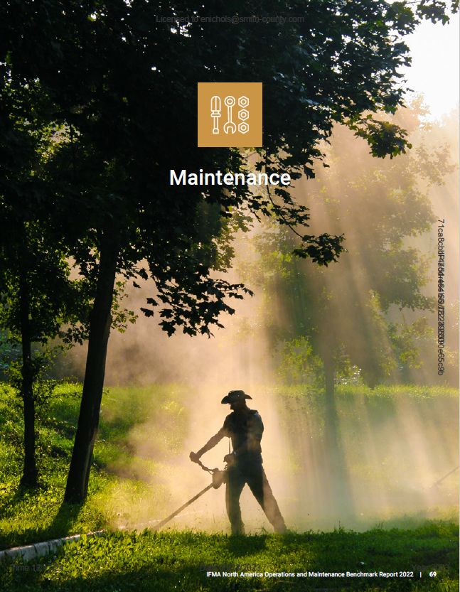
Maintenance

Slide 36
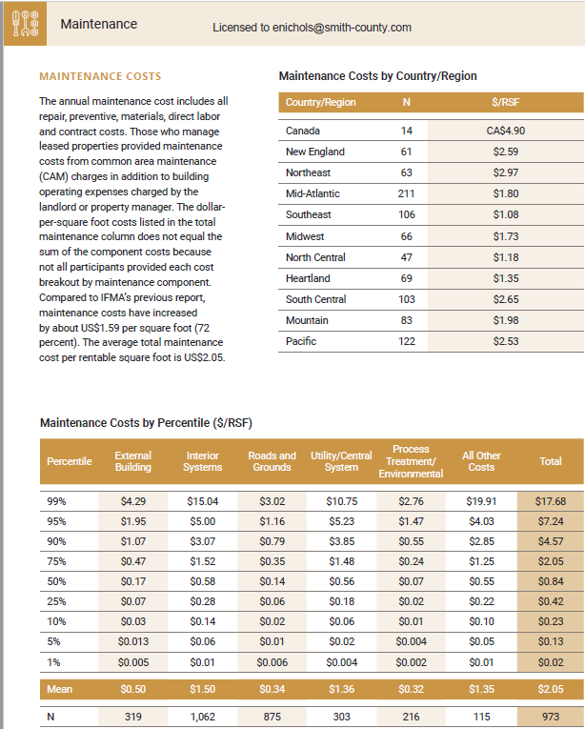
Maintenance Costs
We currently provide maintenance to 732,941 square feet for approximately $2.49 per square foot.

Slide 37
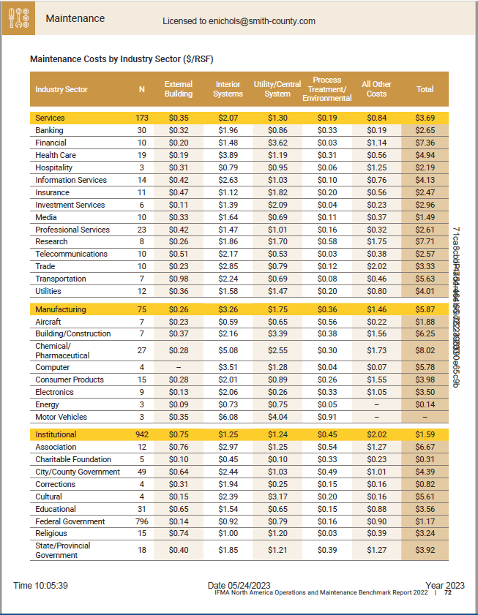
Maintenance Costs by Industry Sector

Slide 38
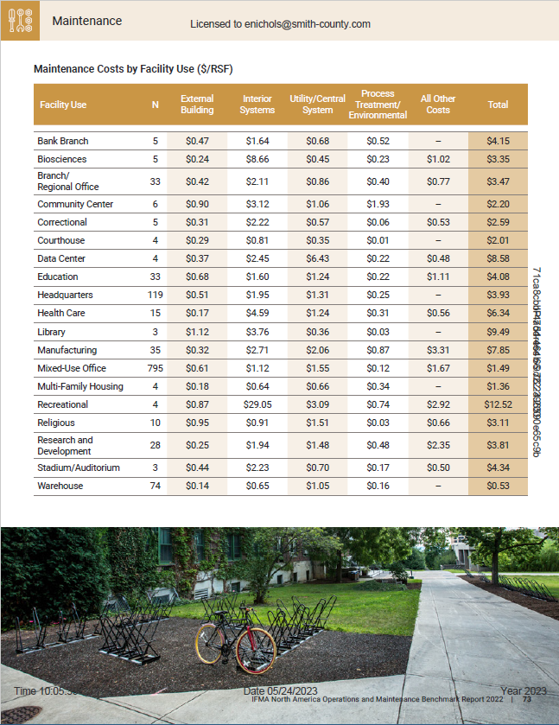
Maintenance Costs by Facility Use

Slide 39
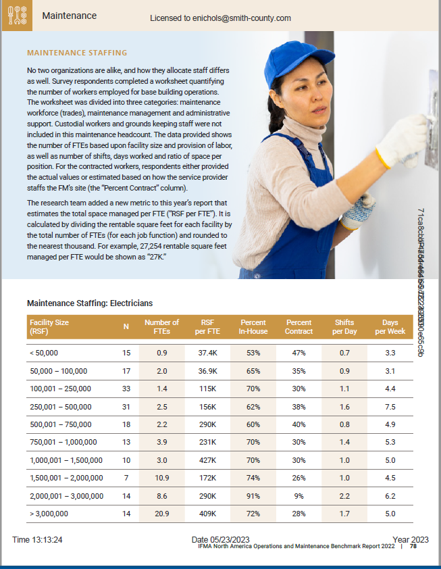
Maintenance Staffing: Electricians

Slide 40
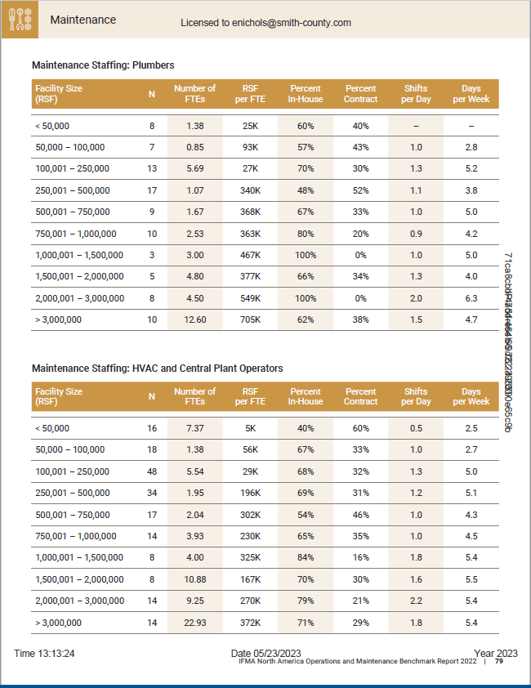
Maintenance Staffing

Slide 41
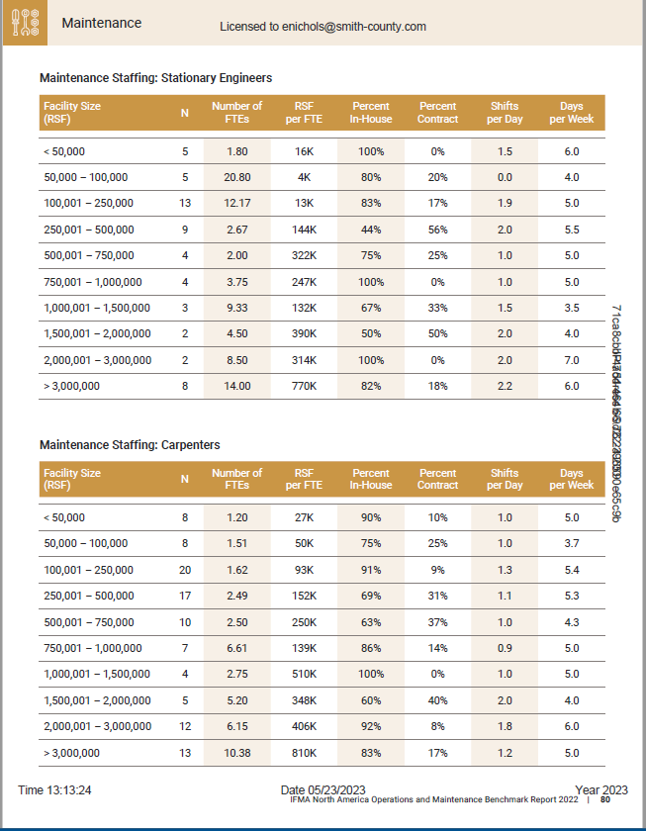
Maintenance Staffing: Engineers and Carpenters

Slide 42
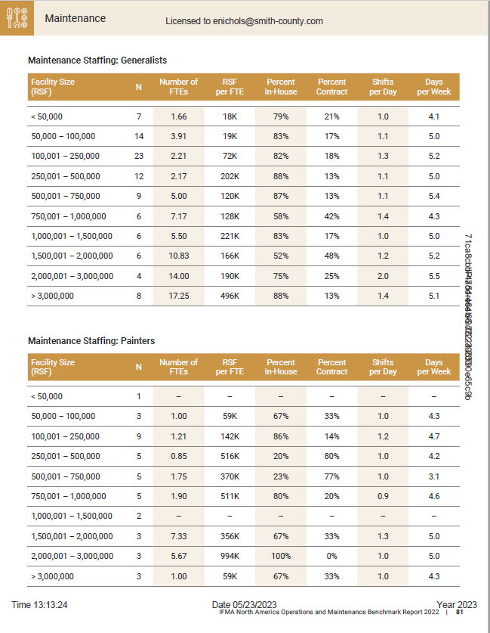
Maintenance Staffing: Generalists and Painters

Slide 43
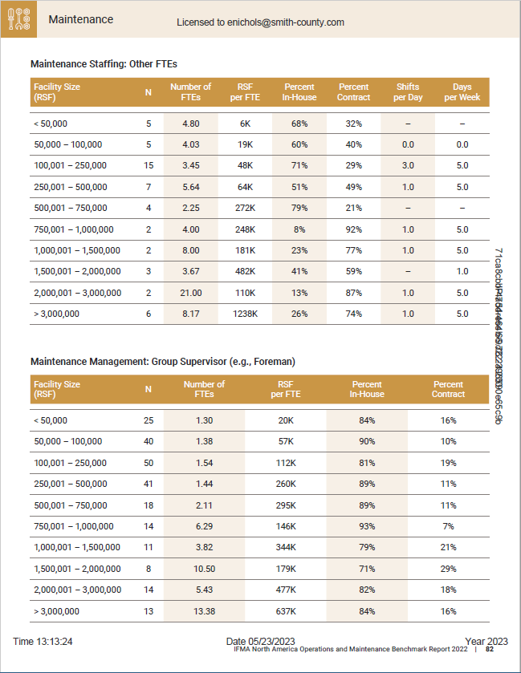
Maintenance Staffing: Other FTEs and Group Supervisor

Slide 44
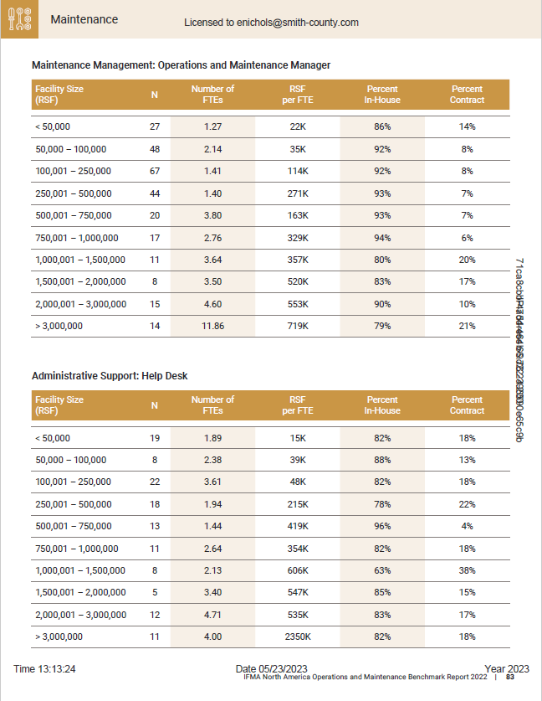
Maintenance Staffing: Operations, Maintenance Manager and Help Desk

Slide 45
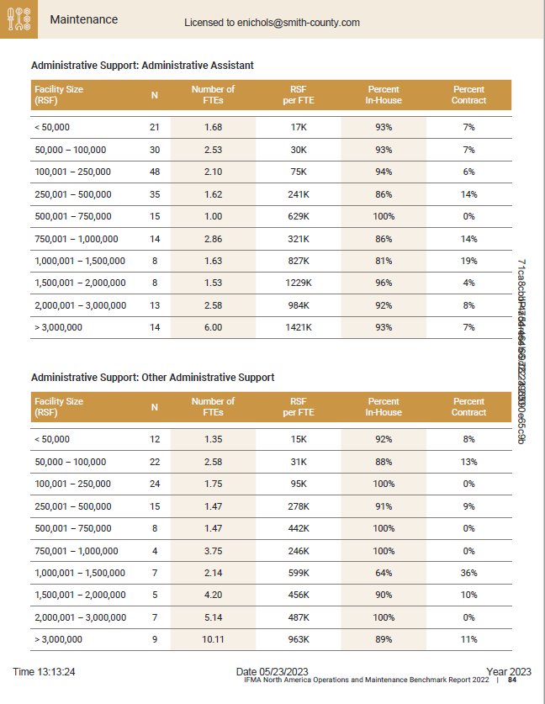
Maintenance Staffing: Administrative Assistant and Other Administrative Support

Slide 46
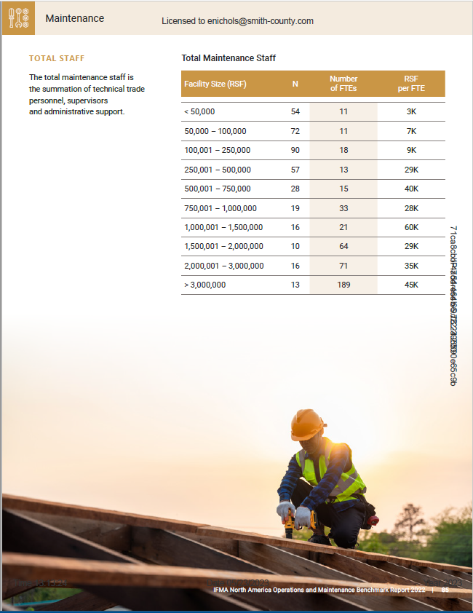
Total Maintenance Staff

